Slide 1
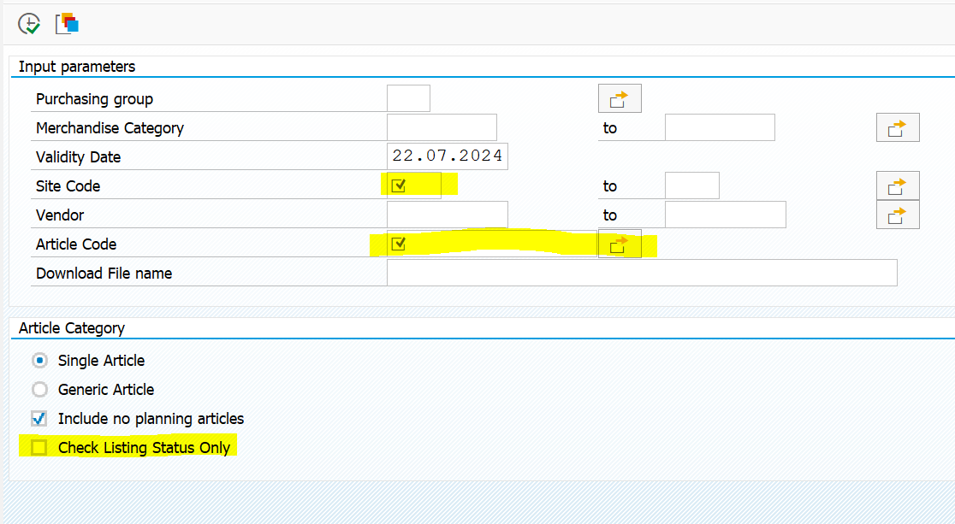
zlist - To check Listing Status
To check site-article-vendor listing
1. Enter Site Code
2. Enter Article Code
To check site-article listing
1. Enter Site Code
2. Enter Article Code
3. Tick on check listing status only

Slide 2
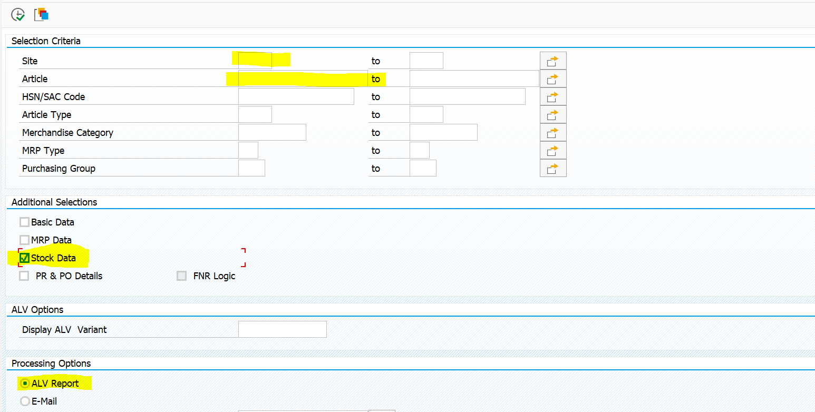
ym2r - To check MAP
To check MAP
  1. Click on ALV report
  2. Tick on Stock Data
  3. Enter site code & article code

Slide 3
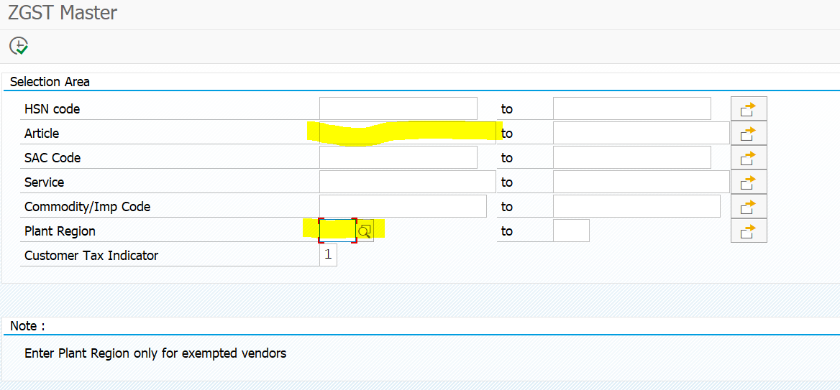
zgst - To get GST (Tax %) of article
To get GST
  1. Enter article code
  2. Click on magifying glass on "Plant Region" field and select state

Slide 4
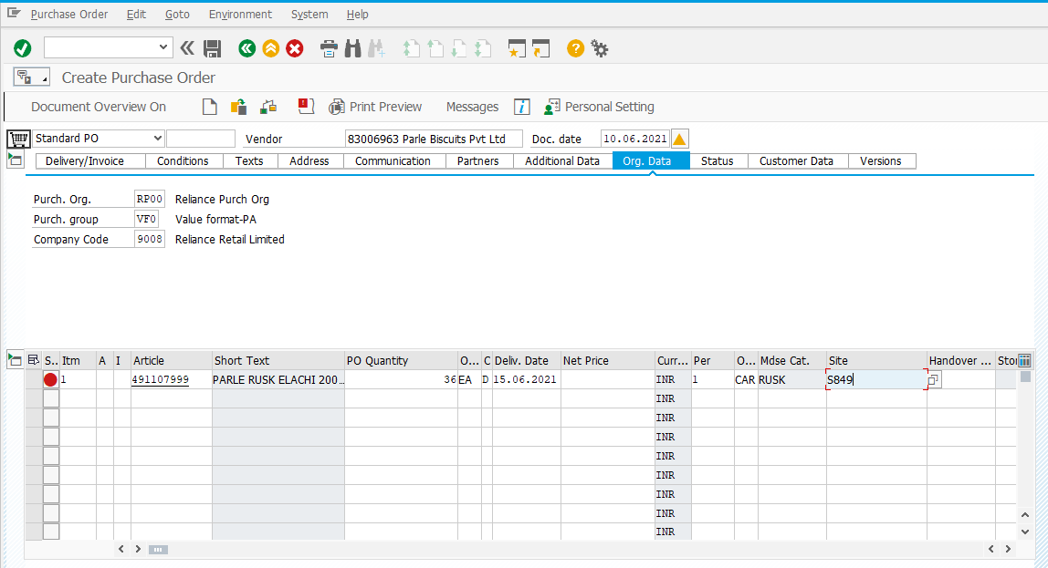
me21n - To create PO / STO
To create PO
1. Enter purchase org. - RP00
purchase grp - VF0
company code - 9162
2. Enter vendor code, article code, PO qty, delivery date, & site code
3. Press Enter

Slide 5
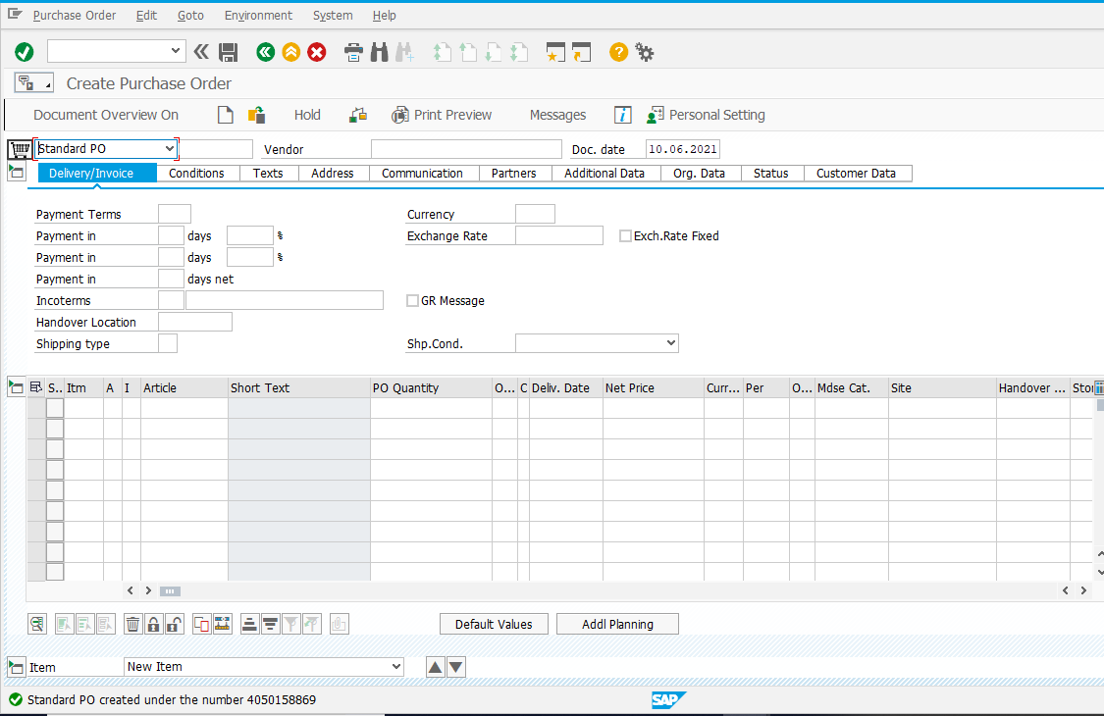
me21n - To create PO / STO
To create PO
4. Save PO (Ctrl + S) or press on save button on top
5. Double click on PO number highlighted below and copy the same.

Slide 6
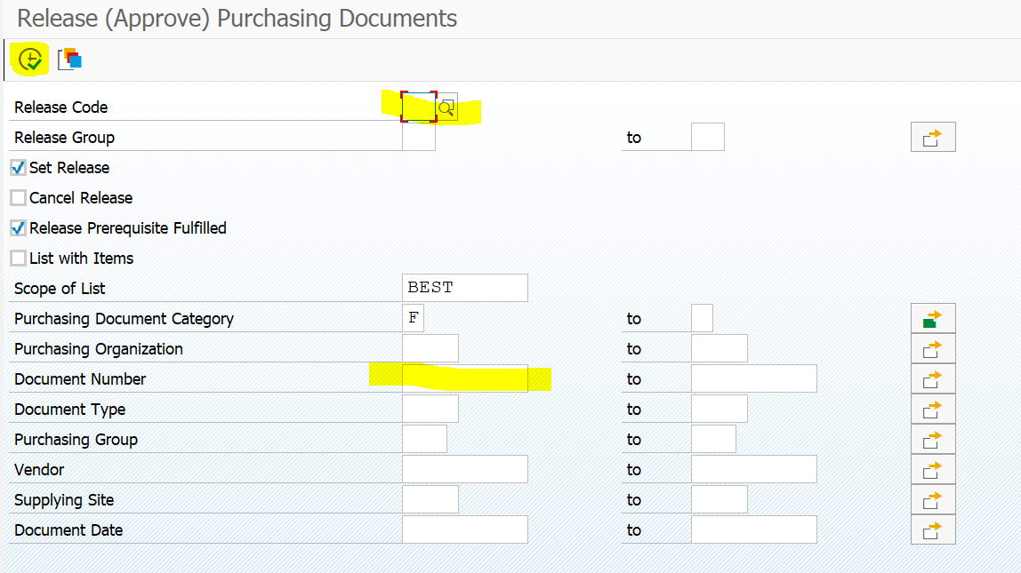
me28 – Release PO
PO must be released by the person who is not creator / author of that PO.
To release PO
1. Enter release code – 00 / 02 / 04
2. Enter PO number in document number field
3. Press Execute button on left-top or press F8
Release Code:
00 – PO Value < 3 Lakhs
02 – PO Value 3 to 5 Lakhs
04 – PO Value > 5 Lakhs

Slide 7
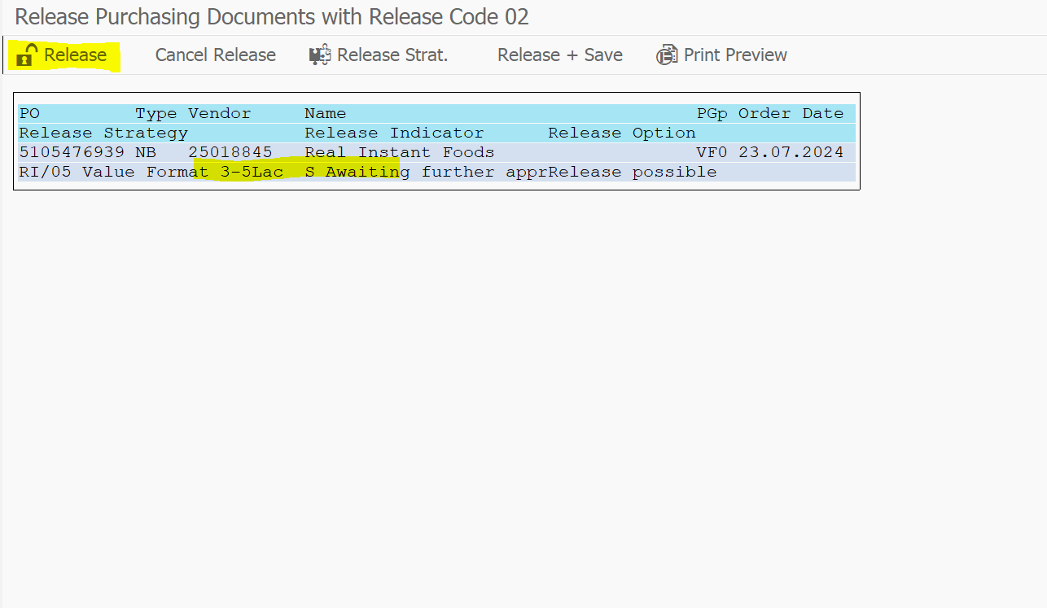
me28 – Release PO
PO must be released by the person who is not creator / author of that PO.
To release PO
4. Click on highlighted line & click on release
5. Save the document (Ctrl + S)

Slide 8
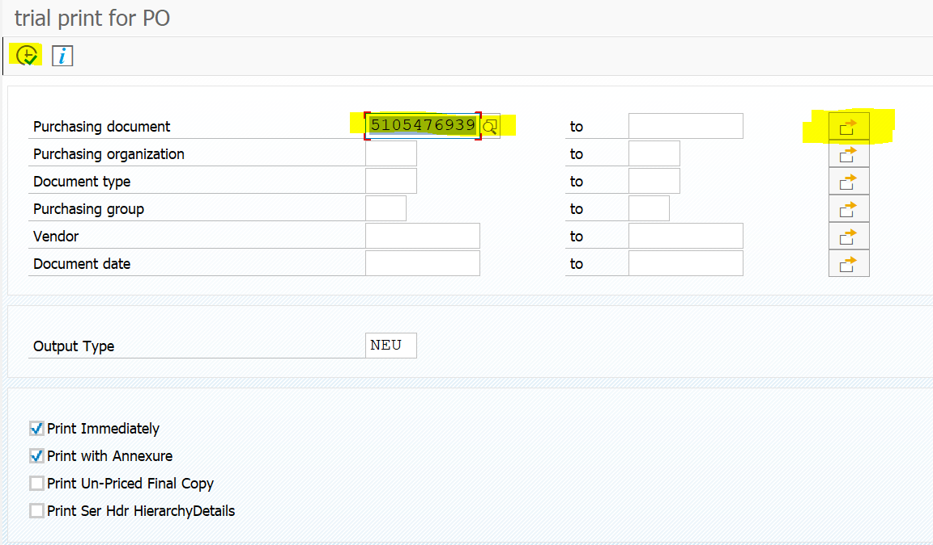
ym42 – PO PDF
1 & 2
To get PO PDF
Enter PO no. in Purchasing document field
Press Execute button on left-top or press F8

Slide 9
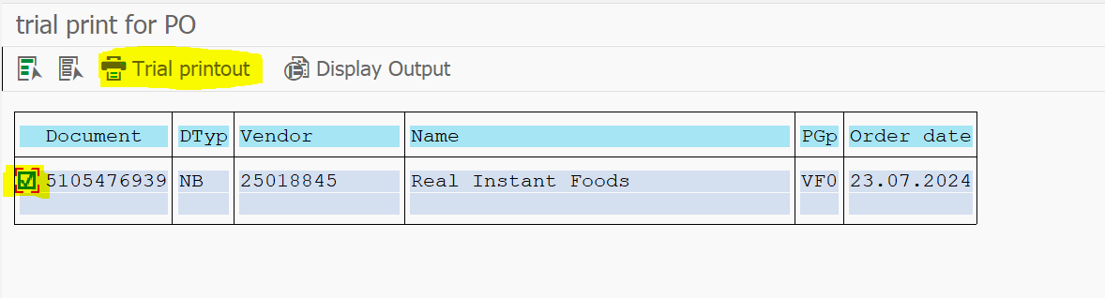
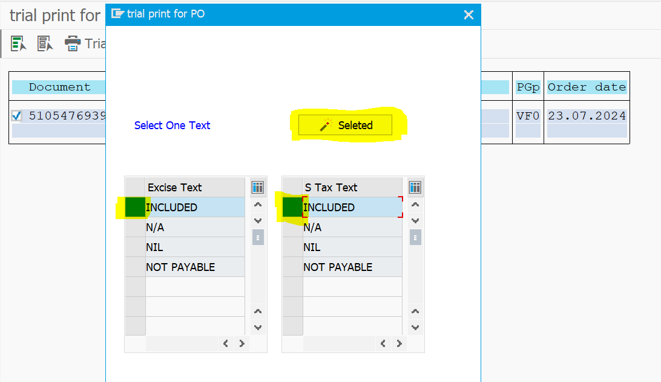
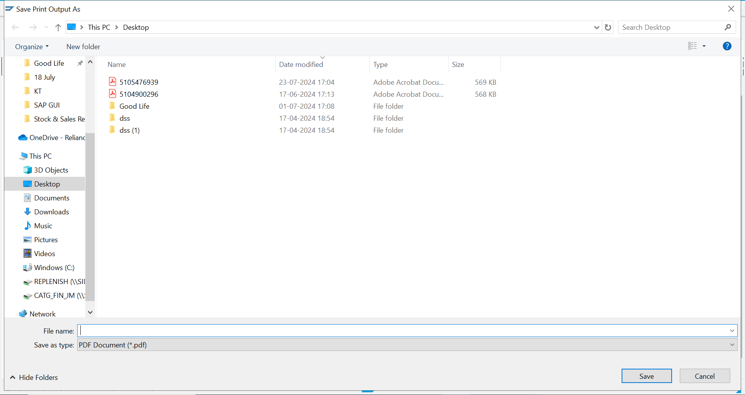
ym42 – PO PDF
3
To get PO PDF
3. Tick on the box beside PO no. & click on trial printout. Trial printout window will appear
4. Click on ‘Included’ box (As highlighted in image) then click on ‘Selected’ button.
5. Save PO as PDF document.
4
5

Slide 10
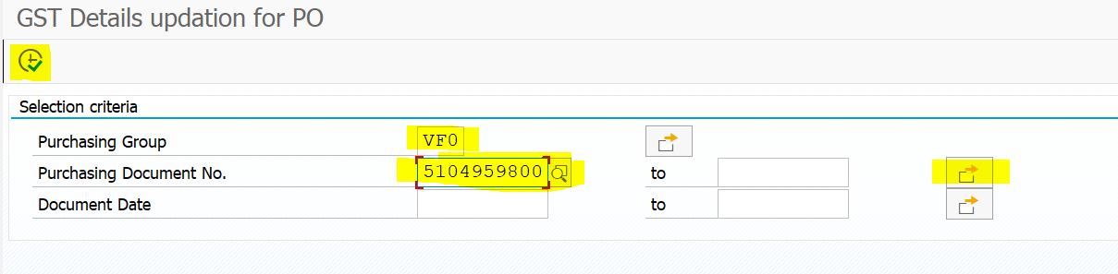
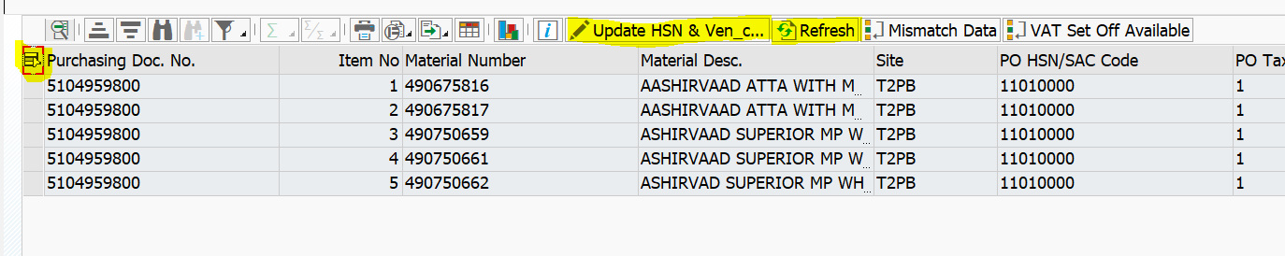
zpohsnupd – To refresh PO
This t-code is used to update PO especially if cost price is updated post creation of PO.
To get PO PDF
Enter purchasing grp – VF0 & PO no. in purchasing document field.
  To enter multiple POs, click on highlighted arrow
2. Press Execute button on left-top or press F8
3. Click on ‘Select All’ field highlighted in left-top side.
4. Click on ‘Update HSN’ & wait for some time
5. Click on ‘Refresh’ & wait for few seconds to update the PO
1a
3

Slide 11
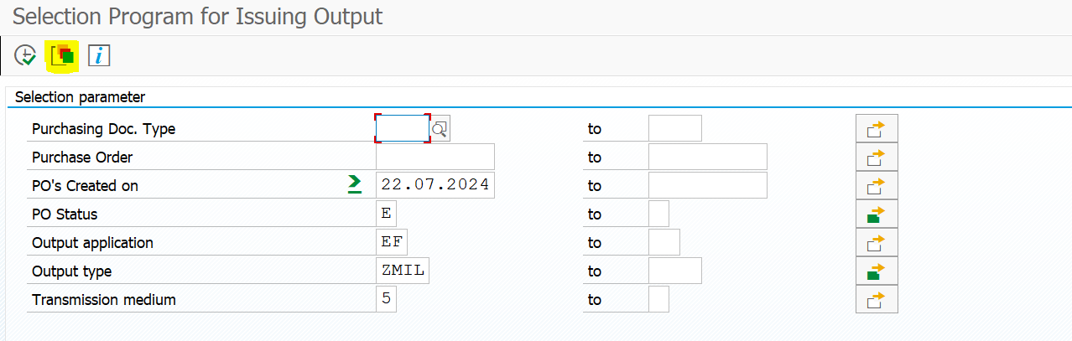
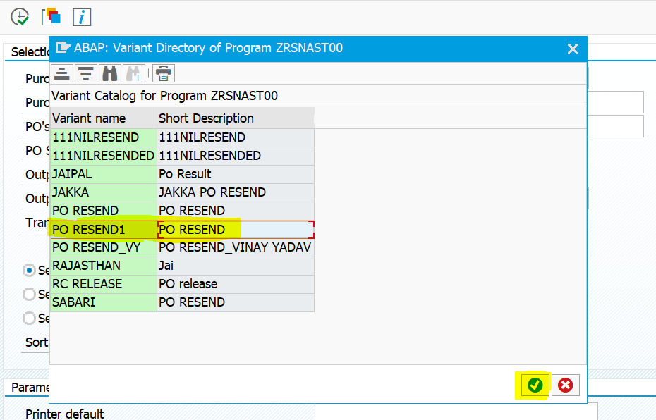
zrrm – To reshoot PO
This t-code is useful only if E-mail ID of vendor is updated in the system. PO will be sent to respective mail id of vendor.
To reshoot PO
Click on ‘Get Variant’ button highlighted in the image
Select ‘PO RESEND1’ and click on ‘Correct Tick’ button

Slide 12
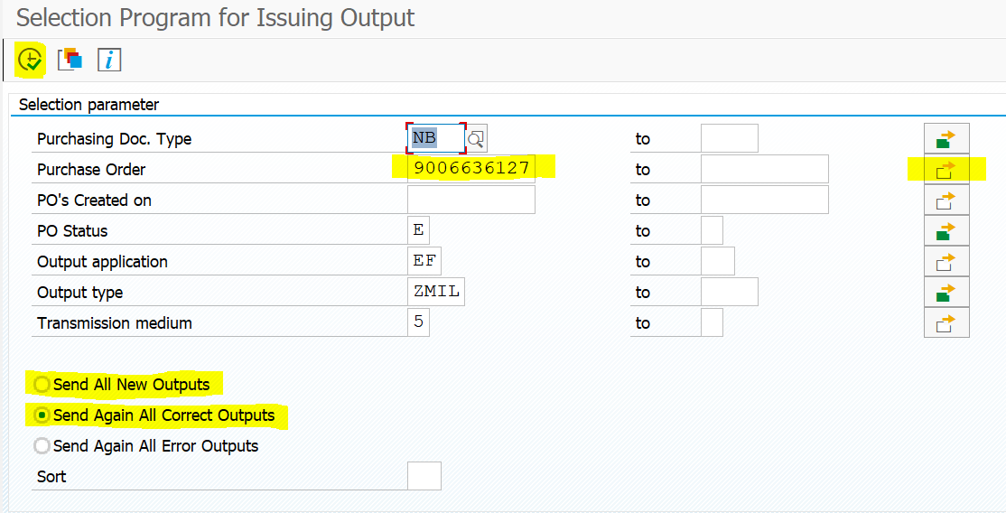
zrrm – To reshoot PO
To reshoot PO
3. Enter PO no. in purchase order field.
  To enter multiple POs, click on highlighted arrow
4. Select ‘Send all new outputs’ if new article is added, else select ‘Send again all correct outputs’
5. Press Execute button on left-top or press F8

Slide 13
Me22n To delete single po
Other purchase order
Insert po no and click other purchase no
Select article no and click on dustbin icon below
Save the document

Slide 14
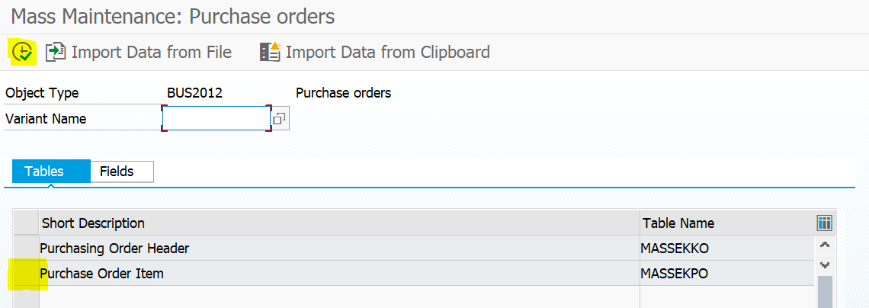
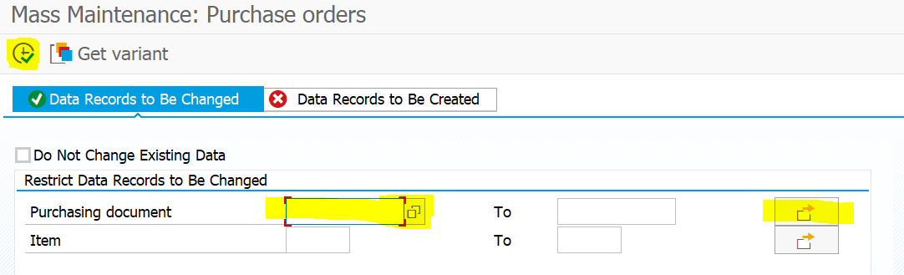
memasspo – To delete / undelete multiple POs
To delete POs
Select on highlighted box beside ‘Purchase Order Item’
Press Execute button on left-top or press F8
Enter PO no. in purchase order field.
  To enter multiple POs, click on highlighted arrow
Press Execute button on left-top or press F8

Slide 15
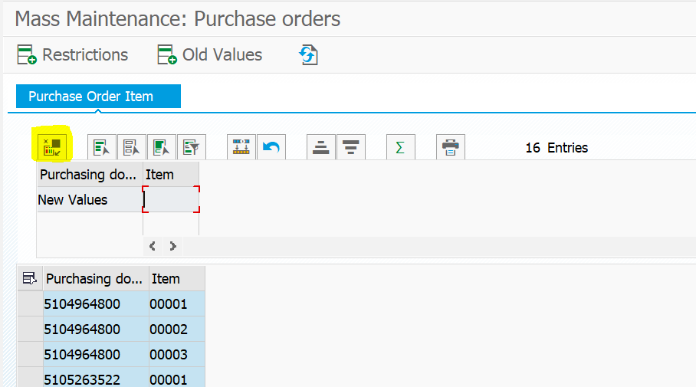
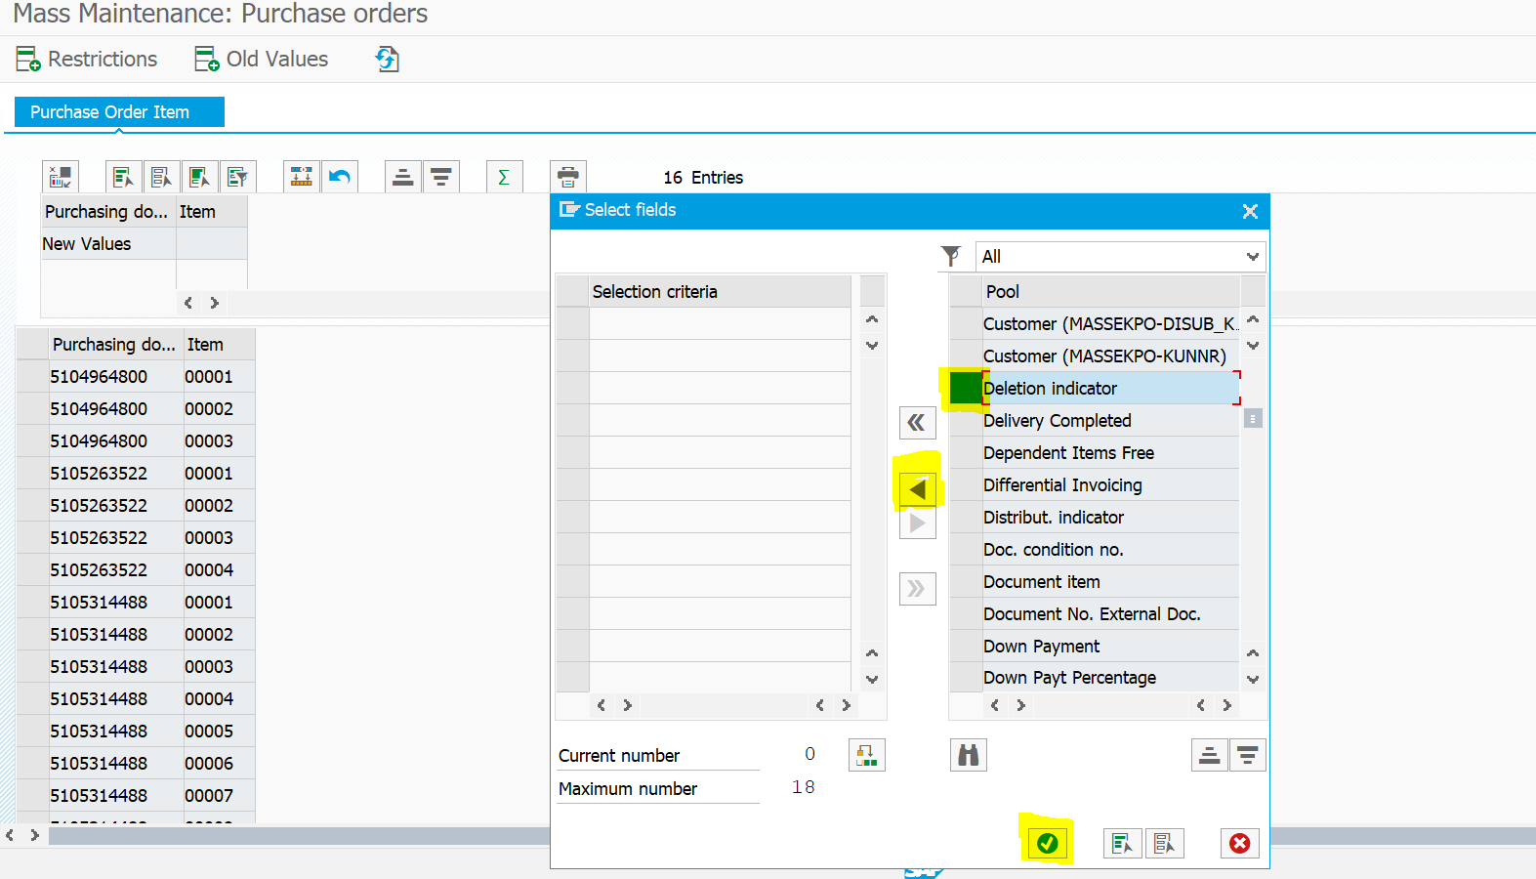
memasspo – To delete / undelete multiple POs
To delete PO
5. Click on highlighted box ‘Select fields’
6. Click on highlighted box beside ‘Deletion Indicator’
7. Click on highlighted arrow and click on ‘Correct tick-mark’ button at bottom.

Slide 16
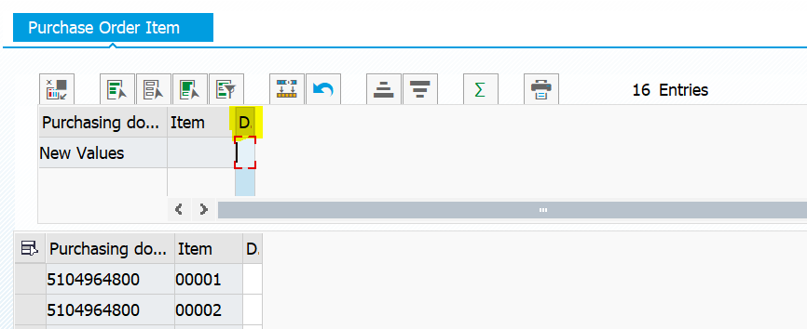
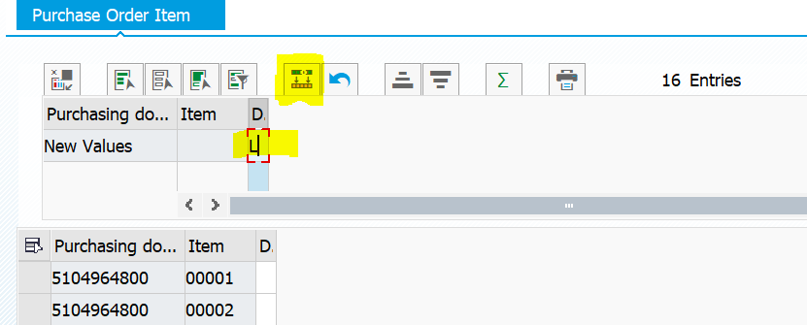
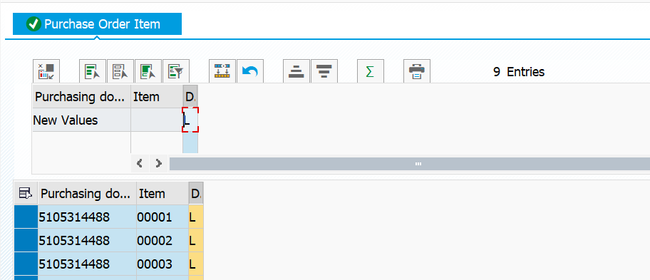
memasspo – To delete / undelete multiple POs
To delete PO
8. New column will get inserted. Click on highlighted area.
9. Enter ‘L’ in the highlighted area.
10. Click on ‘Perform mass change’ button.
11. Deletion indicator ‘L’ will appear in front of all items. Press ‘Ctrl + S’ to save the changes.

Slide 17
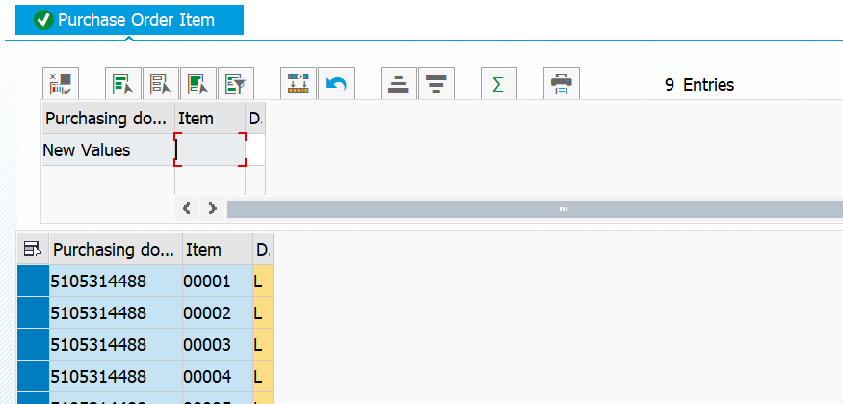
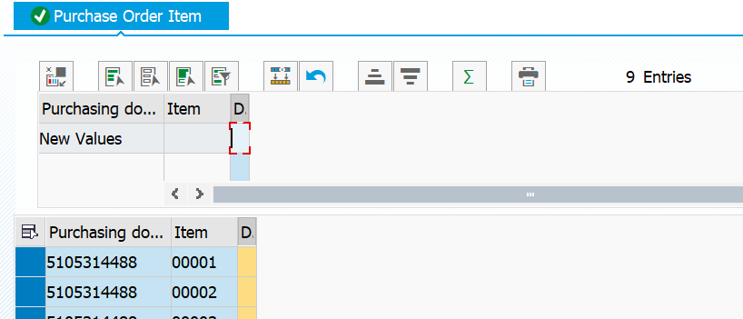
memasspo – To delete / undelete multiple POs
To undelete PO
8. Repeat the process till step 7
9. Remove ‘L’ in the highlighted area.
10. Click on ‘Perform mass change’ button.
11. Deletion indicator ‘L’ will disappear in front of all items. Press ‘Ctrl + S’ to save the changes.

Slide 18
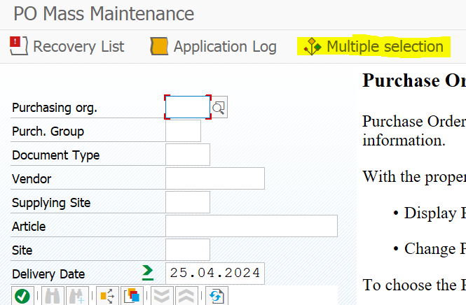
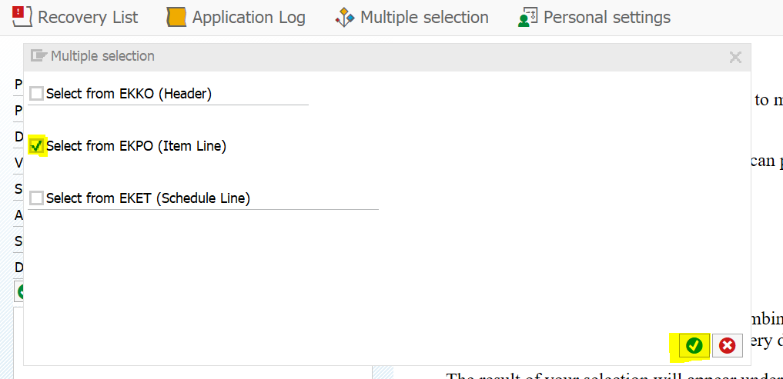
mass_ekko – To extend delivery date of POs
To extend PO delivery date
Click on ‘Multiple selection’ button
Select ‘Select from EKPO (Item Line)’ and click on ‘Correct tick-mark’ button on bottom side.

Slide 19
mass_ekko – To extend delivery date of POs
To extend PO delivery date
Click on ‘Multiple selection’ button
Select ‘Select from EKPO (Item Line)’ and click on ‘Correct tick-mark’ button on bottom side.

Slide 20
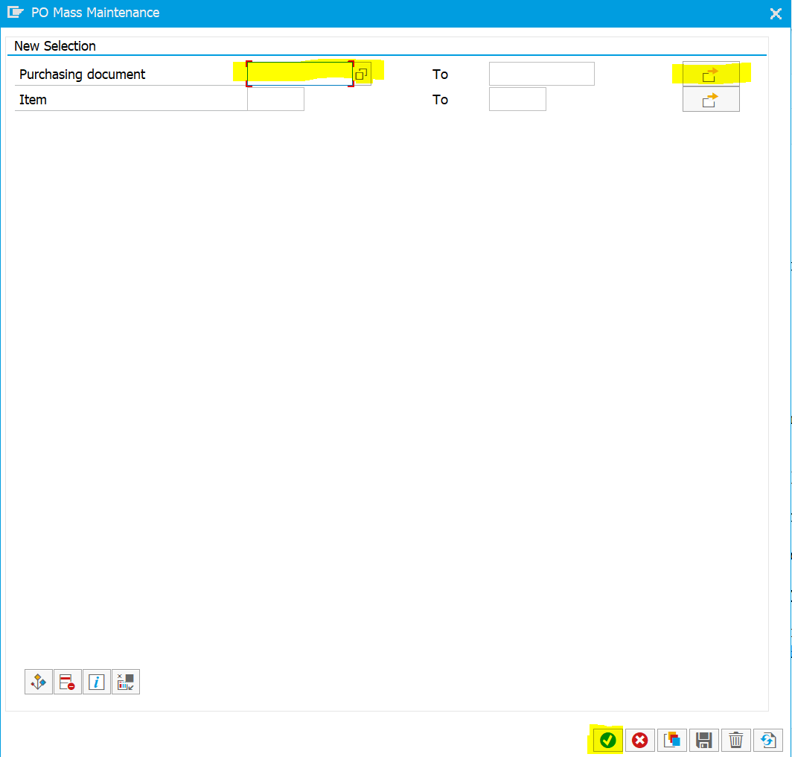
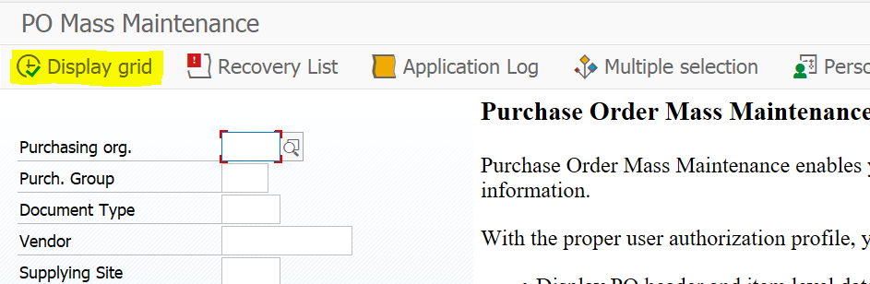
mass_ekko – To extend delivery date of POs
To extend PO delivery date
3. Enter PO no. in purchase document field.
  To enter multiple POs, click on highlighted arrow
4. Click on ‘Correct tick-mark’ button on bottom side.
5. Click on ‘Display grid’ as highlighted in the image.

Slide 21
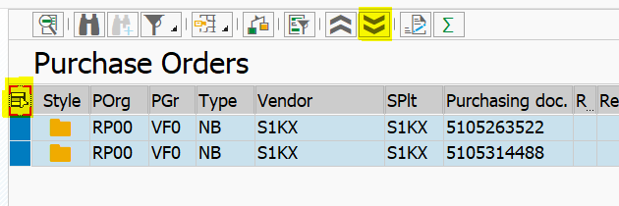
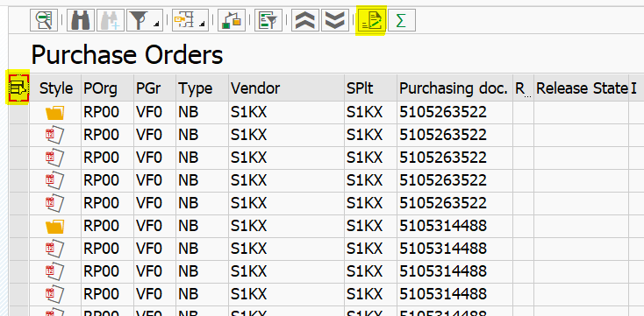
mass_ekko – To extend delivery date of POs
To extend PO delivery date
6. Click on ‘Select All’ button on right-side (highlighted)
7. Click on ‘down arrows’ button on the top to expand all items in the PO.
8. Again, click on ‘Select All’ button on right-side (highlighted) to select all articles in the PO(s).
9. Click on ‘mass change’ button highlighted on the top

Slide 22
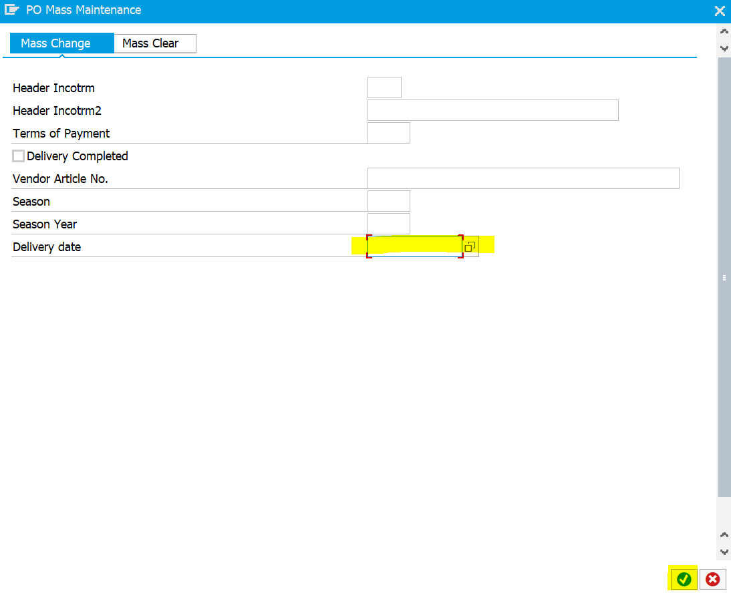
mass_ekko – To extend delivery date of POs
To extend PO delivery date
10. Enter the delivery date in ‘dd.mm.yyyy’ format.
11. Press Execute button on left-top or press F8
12. Press ‘Ctrl + S’ to save the changes.

Slide 23
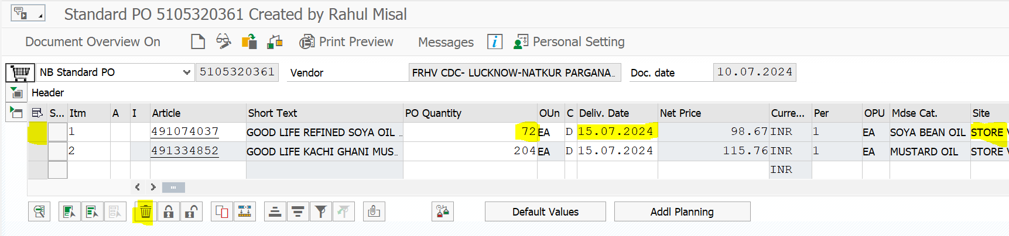
me22n – To edit POs
5
1
2
3
4
Change PO quantity
Change delivery date
Select particular PO line
Delete / Undelete article
Change Site code
Note: Vendor code in the PO can not be changed
Note: Net Price is automatically fetched in the PO

Slide 24
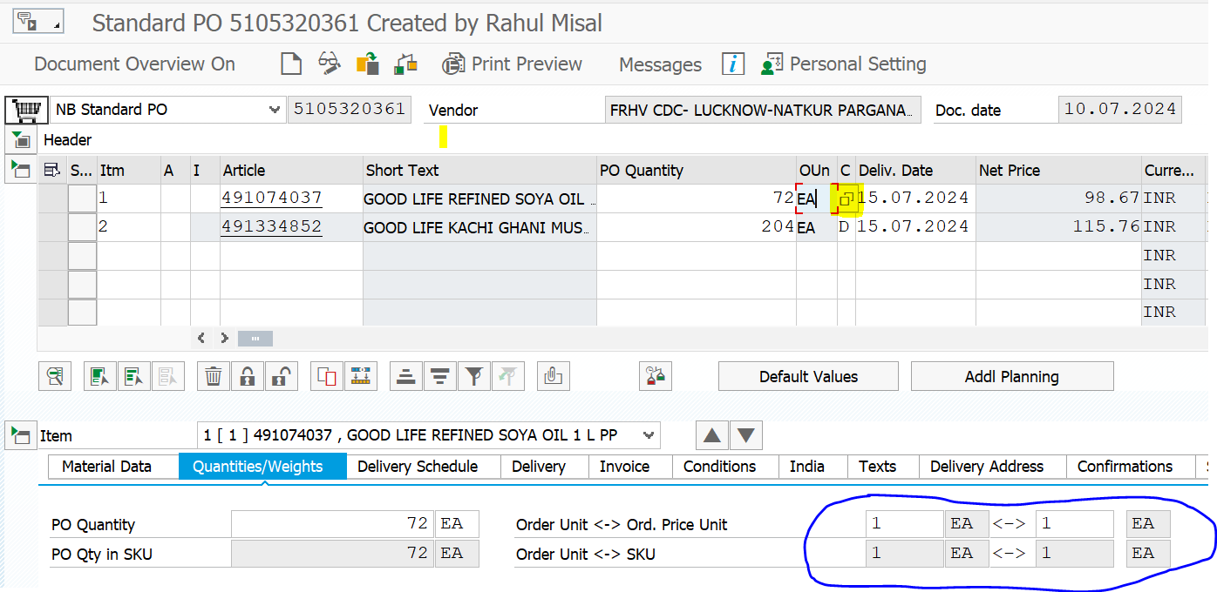
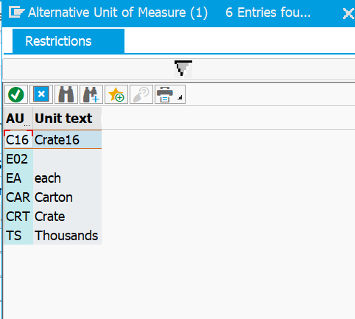
me22n – To edit POs
2
1
To change case lot
  Click on highlighted area under ‘Oun’ field
  A window will appear similar to image 2
  Double click required case lot
  Updated case lot size & total count of SKUs will appear in blue circled area

Slide 25
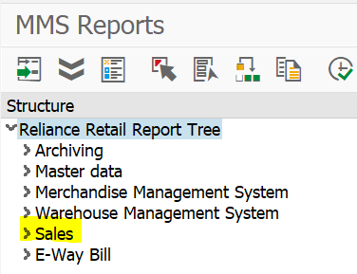
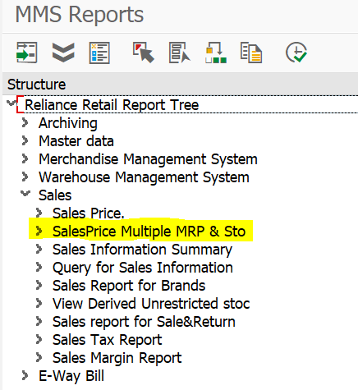
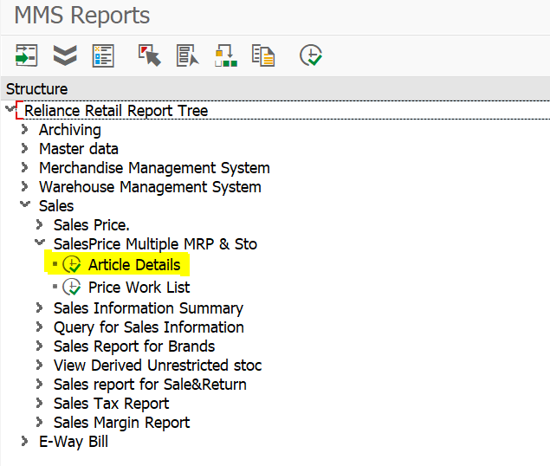
zrmmrep – To get sales price & MRP
1
2
3
To get sales price & MRP
  Click on highlighted area – Sales field
  Click on highlighted area – SalesPrice Multiple MRP & Sto
  Click on highlighted area – Article Details

Slide 26
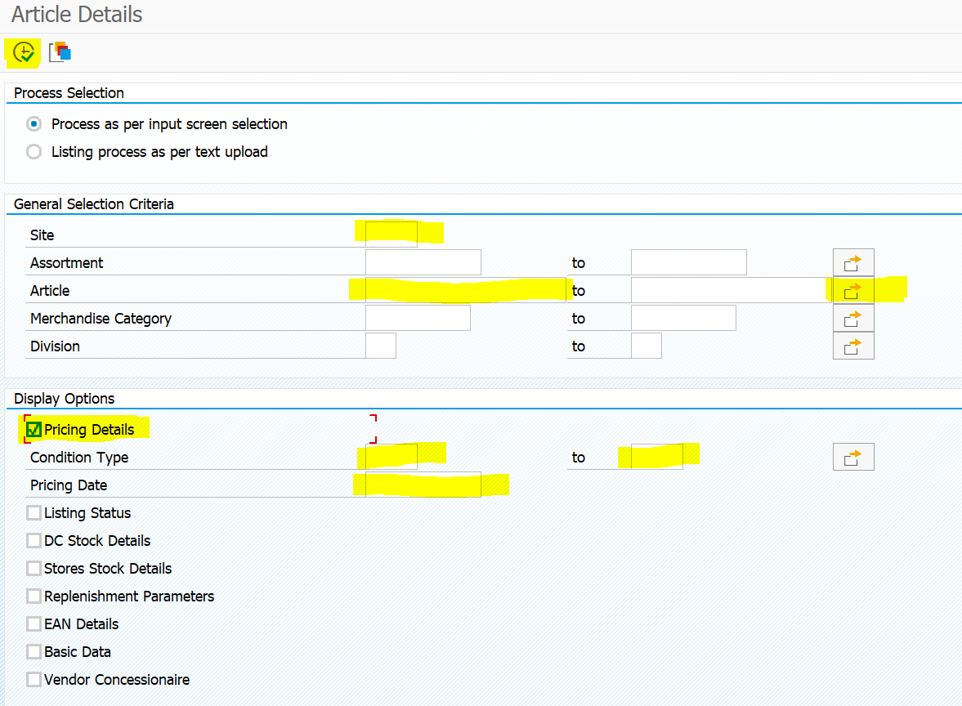
zrmmrep – To get sales price & MRP
To get sales price & MRP
  4. Enter site code in the highlighted area
  5. Enter article code in the highlighted area
  a. To enter multiple article codes, click on highlighted arrow
  6. Click on tick-box in front of Pricing Details
  7. Enter condition ‘VKP0’ in highlighted area – 7
  8. Enter condition ‘ZMR5’ in highlighted area – 8
  9. Enter today’s date as pricing date in highlighted area
  10. Click on Execute button or press ‘F8’
10
4
5
5a
7
8
9
6

Slide 27
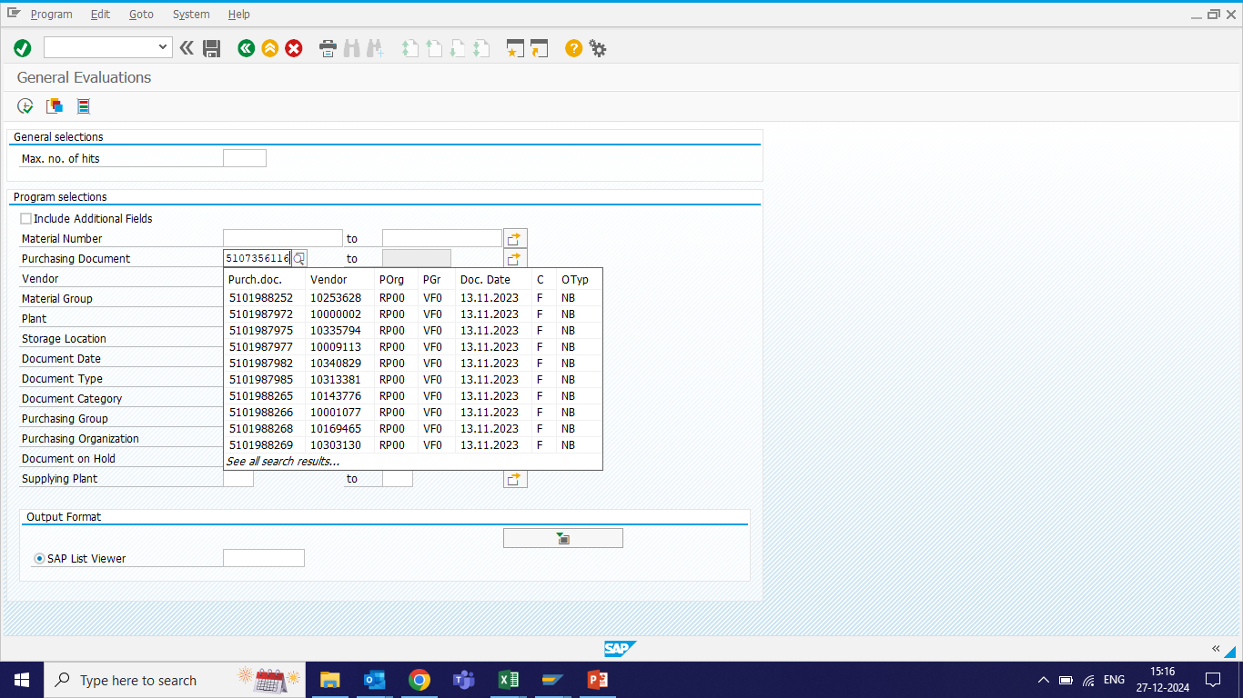
me80fn – To get STO dump
To get STO dump
  In purchasing document insert STO no and execute
  In change view select delivery schedule
  Then export to excel
10
4
5
5a
7
8
9
6

